Slide 1
Research tools and techniques: Measurement scales and checklists
Dr Vinit Kumar

Slide 2
Introduction
Measurement: Assignment of numbers or symbols to characteristics of objects being measured, according to preassigned rules.
The rules for assigning numbers should be standardized and applied uniformly.
Example: Perception, attitude, preferences.
Scaling: Scaling is creating a range or continuum on which measured objects are located. Example: Measurement of attitude : favourable or unfavourable
Scale: Scale is a quantifying measure – a combination of items that is progressively arranged according to value or magnitude. The purpose is to quantitatively represent and item’s, person’s or events place in the scaling continuum.

Slide 3
Example
Consider an attitude scale from 1 to 5.
Each respondent is assigned a number from 1 to 5, with 1 = Extremely Unfavorable, and 5 = Extremely Favorable.
Measurement is the actual assignment of a number from 1 to 5 to each respondent. Scaling is the process of placing the respondents on a continuum with respect to their attitude toward the question.

Slide 4
Scale Characteristics
Description: Description mean the unique labels or descriptors that are used to designate each value of the scale. All scales possess description.
Order: the relative sizes or positions of the descriptors. Order is denoted by descriptors such as greater than, less than, and equal to.
Distance: The characteristic of distance means that absolute differences between the scale descriptors are known and may be expressed in units.
Origin: The origin characteristic means that the scale has a unique or fixed beginning or true zero point.

Slide 5
Levels of measurement or measurement scales
Four kinds of Primary Scales are used for measurement.
Nominal Scale
Ordinal Scale
Interval Scale
Ratio Scale

Slide 6
Nominal Scale
In this scale Numbers identify & classify objects.
Purpose is not to provide order but only to provide labels.
Example: Have you ever visited Lucknow?
Yes – 1
No – 2
Data obtained through Nominal scale can only be counted.
Example: Roll number, Colours, Mobile Number.
"What is your PAN Card number?
Limitations:
No ranking order
Mathematical operations can’t be applied.
Mean and other measures can’t be done. It is just possible to calculated mode.

Slide 7
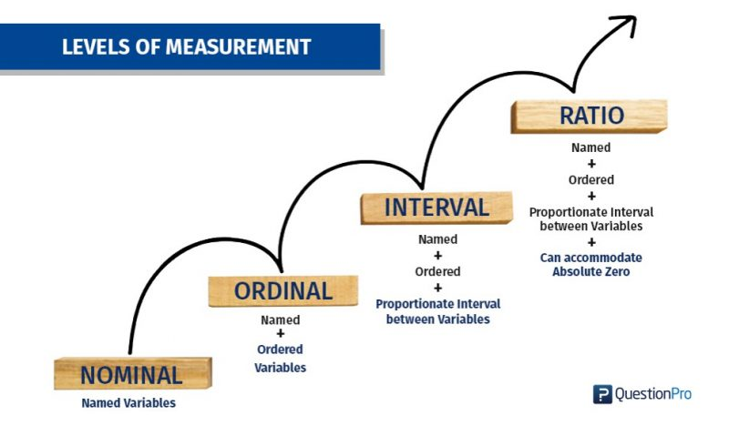

Slide 8
Ordinal Scale
In this scale Numbers identify & classify objects too but the numbers have ordering or ranking.
Purpose is to provide order or rankings.
Example: Rank the following attributes of 1-5 scale according to importance?
Image of an University –
Distance from residence –
National level rank –
Chances of admission –
Data obtained through ordinal scale can be ranked in relation to others but not in absolute terms.
Example: Preferences, perceptions, attitude etc.
Students can be ranked on the basis of grades. A-F
Limitations:
Order is there but the distance between the ranks is not fixed.
Mathematical operations can’t be applied.
Mean and other measures can’t be done. It is just possible to calculated mode, median quartile and percentile.

Slide 10
Interval Scale
More powerful than the nominal and ordinal scales.
The distance given on the scale represents equal distance on the property being measuredPurpose is to provide order or rankings.
Interview scale can tell "How far the objects are apart with respect to an attribute?"
This means that the difference can be compared. Not only the order but also the magnitudes can be compared.
In Interval scale there is no true starting point(or Zero). An arbitrary zero is assumed.
It can be said that two respondents with scale positions 1 and 2 are as far apart as two respondents with scale positions 4 and 5, but not that a person with score 10 feels twice as strongly as one with score 5.
Example: Temperature – 50º Celsius is not double hot than 25º Celsius.
Limitations:
Mean and other measures can be calculated.
Based on “equality of intervals”.

Slide 12
Ratio Scale
Special kind of interval scale that has absolute zero.
In this scale, it is possible to say, how many times greater or smaller one object is being compared to the other.
Highest level of measurement. All statistical techniques can be applied.
Example: weights, lengths and times
For instance, the difference between 5 and 10 minutes is the same as that between 10 and 15 minutes, and 10 minutes is twice as long as 5 minutes.
Ratio scale may tell us "How far the objects are apart with respect to an attribute?"

Slide 14
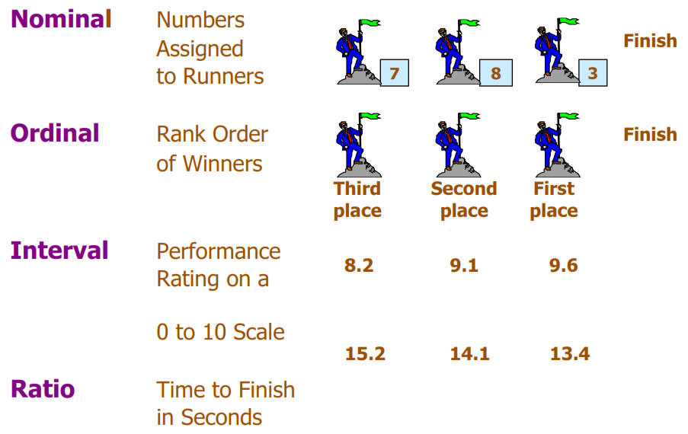

Slide 15
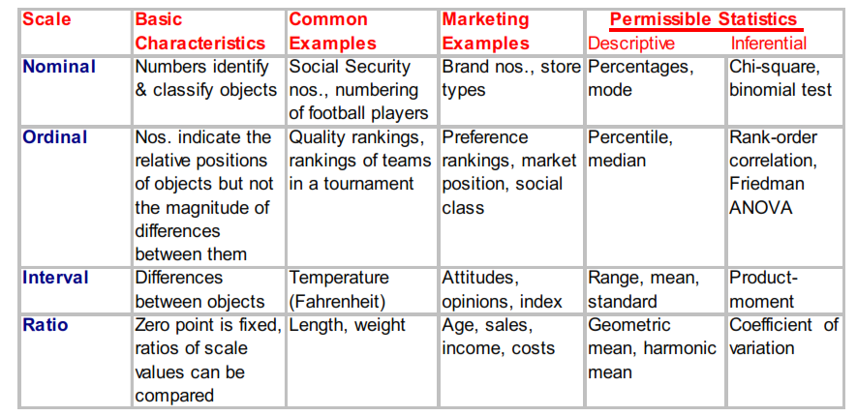

Slide 16
What measurement scale will you use for the following?
Do you own a washing machine?
What is your marital status ?
How many books are there in your library?
How satisfactory is Library’s service?
Describe your preference for the format of information resources?
Your attendance in the Research Methodology class ?
How many members read newspaper in your family?

Slide 17
Techniques of Developing Measurement Tools
Scale construction technique helps in estimate the interest or behaviour of an individual or a group towards others or another's environment rather than oneself.
Points to consider while designing the measurement tool:
Determining the level of the involved data; identifying whether it is nominal, ordinal, interval or ratio.
Identifying the useful statistical analysis for the scale construction.
Identifying the scale construction technique to be used.
Selecting the physical layout of the scales.
Determining the scale categories that need to be used.

Slide 18
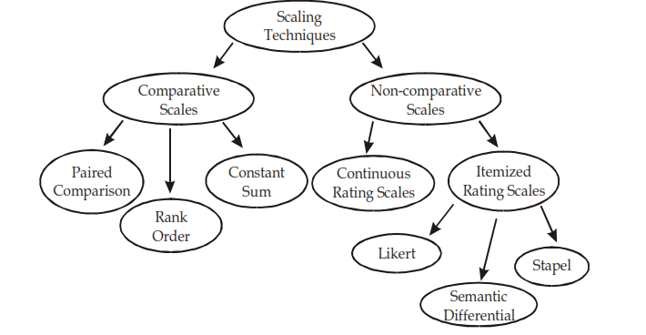
Scaling techniques
Comparative Scales: It involve the direct comparison of two or more objects.
Non-comparative Scales: Objects or stimuli are scaled independently of each other.

Slide 19
Comparative Scaling techniques
It involve the direct comparison of two or more objects.
Respondent is asked to make relative judgements against other similar objects.
Comparative scale data must be interpreted in relative terms and have only ordinal or rank order properties.
Also known as ranking scales

Slide 20

Paired Comparison
The respondent can express his attitude by making a choice between two objects, say between a new library management software and a well known LMS.
For more than two stimuli to judge, the number of judgements required in a paired comparison is given by the formula;
$N= \frac{n(n−1)}{2}$
Where, N = no. of judgements/pairs
n = number of stimuli or objects to be judged.
For ex. For five objects, A, B, C, D, and E
$N= \frac{5(5−1)}{2}$ = 10
A&B | B&D
A&C | B&E
A&D | C&D
A&E | C&E
B&C | D&E

Slide 21
Example: For each pair of professors, please indicate the professor from whom you prefer to take classes.
A&B
A&C
A&D
A&E
B&C
B&D
B&E
C&D
C&E
D&E
Professor | No of time preferred | Rank
A | 4 | 1st
B | 0 | 5th
C | 3 | 2nd
D | 1 | 4th
E | 2 | 3rd
Total | 10
Professor | No of time preferred
A | 4
B | 0
C | 3
D | 1
E | 2
Total | 10
Comparing the total number of preferences for each of the five professors, we find that A is the
most popular, followed by C, E, D and B respectively in popularity.

Slide 22
Rank order scaling
Under this method of comparative scaling, the respondents are asked to rank their choices.
Data obtained is ordinal in nature, arranged or ranked in order of magnitude.
Example: Please rank the professors listed below in order of preference. For the professor you prefer most, assign a “1”, assign a “2” to the professor you prefer the 2nd, and so on.
Professor | Rank order
A
B
C
D
E
Professor | Rank order
A | 4
B | 5
C | 3
D | 1
E | 2
We find that D is the most popular, followed by E, C, A and B respectively in popularity.

Slide 23
Constant Sum Scaling
Respondents are asked to allocate a constant sum of units among a set of stimulus objects with respect to some criteria.
Units allocated represent the importance attached to the objects.
Data obtained are interval in nature
Allows for fine discrimination among alternatives.

Slide 24
Example: Listed below are 5 professors, as well as 4 aspects that students typically find important. For each aspect, please assign a number that reflects how well you believe each instructor performs on the aspect. Higher numbers represent higher scores. The total of all the instructors' scores on an aspect should equal 100.
Professor | Ability to deliver relevant content | Punctuality | Availability | Regularity
A
B
C
D
E
Sum total | 100 | 100 | 100 | 100

Slide 25
Relative Advantages of Comparative Scales
• Small differences between stimulus objects can be detected.
• Same known reference points for all respondents.
• Easily understood and can be applied.
• Involve fewer theoretical assumptions.
• Tend to reduce halo or carryover effects from one judgment to another.

Slide 26
Non-Comparative Scaling techniques
Non-comparative Scales: Objects or stimuli are scaled independently of each other.
Each object is scaled independently of the others in the stimulus set. The resulting data are generally assumed to be interval or ratio scaled.
Respondents evaluate only one object at a time, and for this reason non-comparative scales are often referred to as monadic scales.
Also known as rating scales or categorical scales.

Slide 27
Continuous Rating Scale
Respondents rate the objects by placing a mark at the appropriate position on a line that runs from one extreme of the criterion variable to the other.
There are variety of forms of continuous scale.
Example: How would you rate Koha as a LMS?
Version 1
Probably the worst - - - - - - -I - - - - - - - - - - - - - - - - - - - - - - Probably the best
Version 2
Probably the worst - - - - - - -I - - - - - - - - - - - - - - - - - - - - - - --Probably the best
0 10 20 30 40 50 60 70 80 90 100
Version 3
Very bad Neither good nor bad Very good
Probably the worst - - - - - - -I - - - - - - - - - - - - - - - - - - - - - - - ---Probably the best
0 10 20 30 40 50 60 70 80 90 100

Slide 28
Itemized Rating Scales
• The respondents are provided with a scale that has a number or brief description associated with each category.
• The categories are ordered in terms of scale position, and the respondents are required to select the specified category that best describes the object being rated.
• The commonly used itemized rating scales are the Likert, semantic differential, and Stapel scales.

Slide 29
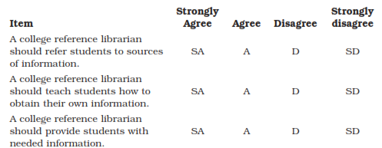
Likert Scale
This consist of a series of statements concerning an attitude object. Each statement has ‘5 points’, Agree and
Also known as summated rating scale as the scores of the individual items are summated to produce a total score for the respondent.
Consists of two parts; item part and evaluation part.
Item part is usually usually a statement about a certain product, event or attitude. Evaluation part is a list of responses like "strongly agree" to "strongly disagree".

Slide 30

The respondents' overall attitude is measured by summing up his (her) numerical rating on the statement making up the scale. Since some statements are favourable and others unfavourable, it is the one important task to be done before summing up the ratings. “Strongly agree” category is favourable whereas “Strongly disagree” category is unfavourable. +2, +1, 0, -1, -2. 0r 1-5
The higher the respondent’s score the more favourable is the attitude.
The scale must contain an equal number of favourable and unfavourable statements
The major disadvantage of summated or Likert-type scales is that, since they represent an ordinal scale of measurement, they do not permit one to say anything about the exact amount of differences in attitudes.
For example, one could not say that a respondent who checked “strongly disagree” was twice as unfavourable toward some library service as a respondent who checked “disagree.”

Slide 31
Semantic Differential Scale
very similar to the Likert Scale
Consists on a list of items to be rated by the respondent.
Unlike Likert scale, it uses “Bipolar” phrases or adjectives.
Each pair is separated by a seven point scale.
The computation is done the same way like Likert scale.
Example: In your opinion for a database what aspects matters you. Please tick one of the seven categories which describes your views.

Slide 32
Example: In your opinion for a database what aspects matters. Please tick one of the seven categories which describes your views.
Sr. No. | Aspect | -3 | -2 | -1 | 0 | 1 | 2 | 3
1. | Poor Retrieval |  |  |  |  |  |  |  | Good retrieval
2. | User friendly UI |  |  |  |  |  |  |  | Not so friendly UI
3. | Poor brand Image |  |  |  |  |  |  |  | Good brand Image
4. | Good support |  |  |  |  |  |  |  | Bad support
5. | High Price |  |  |  |  |  |  |  | Adequately priced
The respondent is asked to tick one of the seven categories which describe their views or attitude.

Slide 33
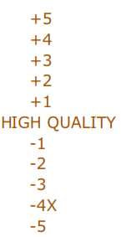
Stapel Scales
Single adjective or substitute for the semantic differential when it is difficult to create pairs of bipolar adjectives.
The Stapel scale is a unipolar rating scale with ten categories numbered from -5 to +5, without a neutral point (zero). This scale is usually presented vertically.

Slide 34
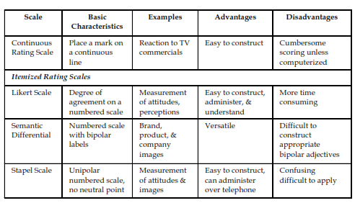
Basic Non-Comparative scales

Slide 35
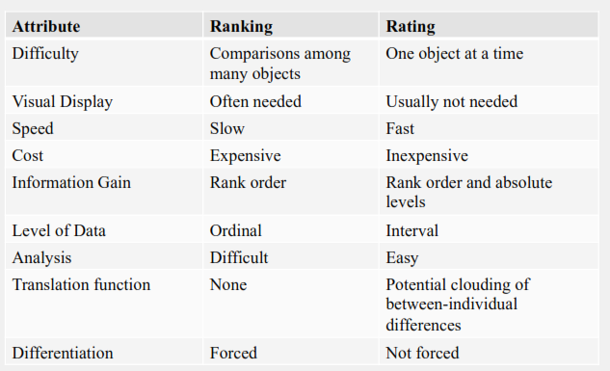
Ranking vs Rating

Slide 36
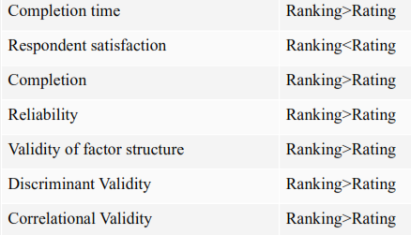
Combining ranking and rating both scales.
Rank first then rate

Slide 37

Evaluation of Scale
The scale must be evaluated before the scale is used for measurement.
Reliability
Reliability means the extent to which the measurement process is free from errors. Reliability deals with accuracy and consistency. The scale is said to be reliable, if it yields the same results when repeated measurements are made under constant conditions.
Validity
The paradigm of validity focused in the question "Are we measuring, what we think, we are measuring?" Success of the scale lies in measuring "What is intended to be measured?"
Of the two attributes of scaling, validity is the most important.

Slide 38
Checklists
Checklists are used to encourage or verify that a number of specific lines of inquiry, steps, or actions are being taken, or have been taken, by a researcher.
It helps to ensure consisting and completeness in carrying out a task.
The checklist consists of a list of items with a place to check, or to mark yes or no.
A mnemonic device.
Purpose of checklist is to call attention to various aspects of an object or situation.
reduces the influence of the “halo effect”
Eliminates Double measurement
Evaluate what we can not explain.

Slide 39
Application of Checklists
• Used to record behaviour in observational studies.
• Used in appraisal, studies – of buildings, property, plan, textbooks, instructional procedures and outcomes etc.
• To rate the personality.
• To know the interest of the subjects.
Items in the checklist may be continuous or divided into groups of related items.
Should be arranged in categories and the categories in a logical or psychological order.
Terms used in the items should be clearly defined.
A pilot study should be taken to make it standardized.

Slide 40
Analysis and interpretation of checklists
Frequencies are counted,
Percentages and averages calculated,
central tendencies,
measures of variability and
co-efficient of correlation.
For categorical checklists, checks are added up to give total scores for the category wise total scores can be compared between themselves or with similar scores secured through other studies.

Slide 41
Types of checklists
Mnemonic checklist
Sequential checklist
Iterative checklist
Diagnostic checklist
Criteria of merit Checklist(comlist) – for evaluation purposes
Weighted checklist

Slide 42
Questions??

